Slide 1
Virtual-Memory Management
Benefits of Virtual Memory
Demand Paging
Principle of Working-set Model
Shared memory and Memory-mapped files
How to manage Kernel memory

Slide 2

Other Issues for Paging
Advantages of larger page size
Results in smaller page table
I/O time is minimized
Larger page size minimizes page faults
Relationship between page size and sector size on the paging device is also important
Current trend in architecture is to have a relatively larger page size
TLB Reach
Hit ratio of a TLB increases with the increase in the number of entries in the TLB
TLB reach refers to the amount of memory accessible by the TLB
Number of entries multiplied by the page size

Slide 3
Other Issues for Paging
TLB reach can be doubled by doubling the entries in the TLB
Page size increase also increases the TLB reach
Results in greater internal fragmentation
An operating system may provide several different page sizes to suit the varying requirements
Requires the OS to manage the TLB
A bit in the TLB entry indicates the page size
Software managed TLB - Performance loss
Recent trends indicate a move towards software managed TLBs with multiple page sizes

Slide 4
Other Issues for Paging
Inverted Page Tables
Use of inverted page table reduces the amount of memory required for per-process page tables
Complete information about the logical address space of a process is not present in the inverted page table
External page tables, one per process, must be kept for the required additional information
External page tables are required only when a page fault occurs
They do not need to be available quickly
A page fault may now cause another page fault
Needs to be handled carefully

Slide 5

Synchronization
The Critical Section Problem
Synchronization Hardware
Classic Problems of Synchronization

Slide 6
Process Coordination
A cooperating process is one that can affect or be affected by other processes executing in the system
Cooperating processes can either
Directly share a logical address space or
Are allowed to share data only through files or messages
Concurrent access to shared data may result in data inconsistency
Explore various mechanisms to handle synchronization issues

Slide 7
Synchronization - Objectives
Present Critical Section problem
Solutions are used to preserve data consistency
Hardware and software solutions of the critical section problem
Several classical process-synchronization problems
Tools to solve process synchronization problems

Slide 8
Overview
Cooperating processes and shared data
Critical section problem
Semaphores for mutual exclusion
Hardware support
Synchronization problems
Bounded-buffer problem
Readers-writers problem
Dining-philosophers problem
Monitors
Alternative approaches
Transactional Memory

Slide 9
Background
Provide mechanisms to maintain data consistency of shared data between cooperating processes
Problem
Bounded buffer producer-consumer problem with a modification of adding a variable counter
Counter is initialized to zero
Counter is incremented with the addition of a new item in the buffer
It is decremented every time we remove an item from the buffer
Both routines are correct separately but may not give correct result if they execute concurrently
Value of counter may be incorrect

Slide 10
The Code for the Producer Process
while (true)
{
/* produce an item and put in nextProduced */
while (counter == BUFFER_SIZE)
; // do nothing
buffer [in] = nextProduced;
in = (in + 1) % BUFFER_SIZE;
counter++;
}
Notes:
10

Slide 11
The Code for the Consumer Process
while (true) {
while (counter== 0)
; // do nothing
nextConsumed = buffer[out];
out = (out + 1) % BUFFER_SIZE;
counter--;
/* consume the item in nextConsumed */
}
Notes:
11

Slide 12
Race Condition
counter++ can be implemented as
register₁ = counter
register₁ = register₁ + 1
counter = register₁
counter-- can be implemented as
register₂ = counter register₂ = register₂ - 1 counter = register₂
Notes:
12

Slide 13
Race Condition
One of the interleaving of the counter manipulation functions
T0: producer execute
register1 = counter {register1 = 5}
T1: producer execute
register1 = register1 + 1 {register1 = 6}
T2: consumer execute
register2 = counter {register2 = 5}
T3: consumer execute
register2 = register2 - 1 {register2 = 4}
T4: producer execute
counter = register1 {counter = 6}
T5: consumer execute
counter = register2 {counter = 4}

Slide 14
Synchronization of Processes
When both processes are allowed to manipulate the shared variable concurrently, incorrect values may result
Race condition
Ensure that only one process is allowed to manipulate a shared variable at any time
Processes need to synchronize in some manner
Such situations occur very frequently in operating systems
Process synchronization
Process coordination

Slide 15
The Critical-Section Problem
Consider a set of processes {P₀, P₁,…., P_{n-1}}
Each process consists of a segment of code called a critical section
Changing common variables
Updating a common table
Writing to a shared file
Requirement
No two processes should be executing their critical section at the same time
Critical section problem
Design a protocol that the processes can use to cooperate by requesting permission to enter the CS
Entry section
The section of code implementing the request

Slide 16
The Critical-Section Problem
Exit section
Code that follows the critical section code
Remainder section
The remaining code
General structure of a typical process P_{i}
Solution to the critical section problem must fulfill the following requirements
1. Mutual exclusion
If process P_{i} is executing in its CS
No other process can execute in their CS
2. Progress
If no process is executing in the CS, and some processes wish to enter CS, then
Select one of the waiting processes

Slide 17
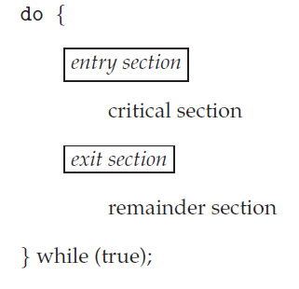
The Critical-Section Problem

Slide 18
The Critical-Section Problem
Selection is made from among the processes that are not in their remainder section
This selection is not postponed indefinitely
3. Bounded waiting
There exists a bound on the number of times that other processes are allowed to enter their CSs after a process has made a request to enter its CS and before that request is granted
Each process is executing at a non-zero speed
Many instances of kernel code manipulating data structures may also suffer from race conditions
Two approaches are used to handle CS in OS

Slide 19
The Critical-Section Problem
Preemptive Kernels
Allows a process to be preempted while it is running in kernel mode
May be more responsive
May suffer from race conditions
Needs to be designed carefully (SMPs)
More suitable for real-time programming
2. Nonpreemptive kernels
Does not allow a process to be preempted while it is running in kernel mode
Free from race conditions
Preemptive kernel are more difficult to design and implement
How to manage preemption in kernel?

Slide 20
Peterson’s Solution
A software-based solution to critical section problem
Algorithm is restricted to two processes that alternate to enter and use the CS
Two data items are shared between the two processes
int turn;
Variable to indicate whose turn it is to enter the CS
boolean flag[2];
An array to indicate whether a process is ready to enter the CS
Working of the algorithm

Slide 21
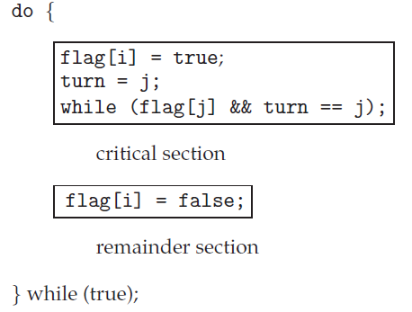
Algorithm for Process P_{i}
Notes:
21

Slide 22
Peterson’s Solution
Prove that the solution meets all three requirements
Mutual exclusion is preserved
P_{i} enters the critical section only if
Flag[j] == false or turn == i
Both processes execute in the CS only if
flag[i] == flag[j] == true
Value of turn would allow only one process to enter CS
The progress requirement is satisfied
The bounded-waiting requirement is met
P_{i} will enter the CS (progress) after at most one entry by P_{j} (bounded waiting)

Slide 23
Synchronization Hardware
Peterson’s solution is a software-based solution
Not guaranteed to work on current architectures
Any solution to CS problem requires a lock
Locks are used to protect the critical regions of code
A process must acquire a lock before entering the CS and release it on exit from the CS
Solutions to CS problem by using simple hardware techniques or by using instructions available in many architectures
Disable interrupts while a shared variable is being modified in a uniprocessor architecture
Approach taken by nonpreemptive kernels

Slide 24
Synchronization Hardware
Not a feasible solution in a multiprocessor architecture
System clock will be affected because most system clocks are updated through interrupts
Use special instructions that execute atomically
Test and modify a variable
test_and_set() instruction
If two processes execute the instruction at the same time, they will be executed in sequence in some arbitrary order
Used as a solution to the CS problem
compare_and_swap () instruction operates on three operands
The instruction is executed atomically

Slide 25
test_and_set ( ) Instruction Definition
boolean test_and_set (boolean *target)
{
boolean rv = *target;
*target = true;
return rv;
}
Notes:
25

Slide 26
Solution using test_and_set ( )
do {
while ( test_and_set (&lock ))
; /* do nothing */
/* critical section */
lock = false;
/* remainder section */
} while (true);
Notes:
26

Slide 27
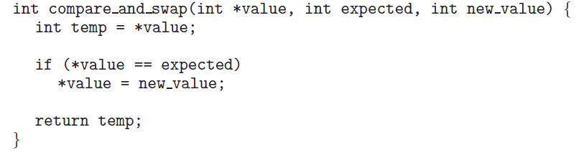
The definition of compare_and_swap () Instruction
Notes:
27

Slide 28
Synchronization Hardware
Mutual exclusion through the use of compare_and_swap() instruction
A global Boolean variable lock is initialized to 0
First process that invokes the instruction sets the lock to 1
Both the algorithms satisfy the mutual exclusion requirement
Bounded-waiting requirement is not satisfied

Slide 29
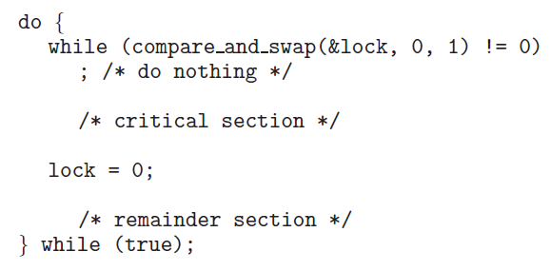
Mutual exclusion implementation with compare_and_swap () instruction
Notes:
29

Slide 30
Synchronization Hardware
Another algorithm using test_and_set() and common data structures
boolean waiting [n]; initialized to false
boolean lock; initialized to false
Satisfies all the three CS requirements
All the algorithms depend on the implementation of the instructions atomically
Implementation is not a trivial task on multiprocessors
Other relatively simpler solutions are desired

Slide 31
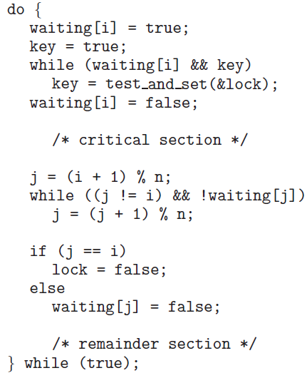
Bounded-waiting Mutual Exclusion with test_and_set()

Slide 32
Mutex Locks
Hardware based solutions are complex
Inaccessible to application programmers
OS designers build software tools to solve the CS problem
mutex locks
Use mutex lock to protect the CS
Prevent race conditions
Mutex lock structure
Uses boolean variable ‘available’ that indicates whether the lock is available or not
Acquire() and release() functions
Call to acquire() and release() functions are atomic

Slide 33
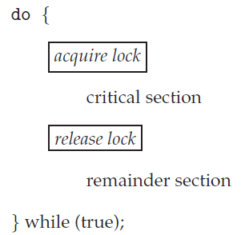
Solution to CS problem using Mutex Locks

Slide 34
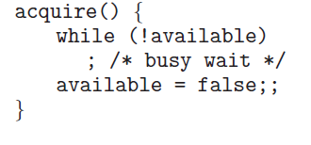
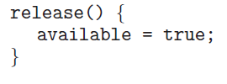
Acquire and release definitions

Slide 35
Mutex Locks
Main disadvantage of implementation is that it requires busy waiting
Mutex lock is also called spinlock
Process spins while waiting for the lock to become available
Problem in real multiprogramming systems because the CPU is not available for other programs
Advantage
No context switch is required in spinlocks
Spinlocks are useful when locks are to be held for a short time

Slide 36
Semaphores
Mutex are the simplest synchronization tools
A more robust tool that provides more sophisticated ways for processes to synchronize
A semaphore S is an integer variable that can be accessed only through two atomic operations
wait() and signal()
The wait() operation was originally termed as P (proberen (Dutch): to test)
The signal() operation was termed as V
(verhogen: to increment)
Definitions of wait() and signal()
Both the operations should be performed indivisibly
Mutual exclusion is also required

Slide 37
Semaphore
Definition for wait()
wait (S) {
while (S <= 0)
; // busy wait
S--;
}
Definition for signal()
signal (S) {
S++;
}
Notes:
37

Slide 38
Usage of Semaphores
Counting semaphores
The value can range over an unrestricted domain
Can be used to control access to a given resource consisting of a finite number of instances
Counting semaphores are initialized to the number of resources
Binary semaphores
The value can range only between 0 and 1
Also referred to as mutex locks
Locks that provide mutual exclusion
Binary semaphores are used to deal with the CS problem for multiple processes
Semaphores can also be used to solve various synchronization problems

Slide 39
Usage of Semaphores
In counting semaphore, each process that wishes to use a resource
Performs a wait( ) operation
The process performs a signal( ) operation when it releases the resource
For synchronization problems
P1 with a statement S1 and P2 with a statement S2
S1; wait (synch);
Signal (synch) S2;
Synch is initialized to zero
Notes:
39

Slide 40
Implementation of Semaphores
Requirement of busy waiting is the main disadvantage with the semaphore definition
This keeps the CPU busy while the semaphore is in spinlock
The definition of wait() and signal() operations are modified to overcome busy waiting
A process blocks if the semaphore value is not positive
CPU can be allocated to another process
When a signal() is executed on the semaphore, the process is restarted by a wakeup() operation
Process moves into ready state
Block() and wakeup(P) are basic system calls
This implementation may have negative semaphore values – magnitude indicates the number of processes waiting on that semaphore

Slide 41
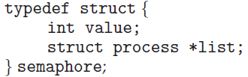
Semaphore Implementation with no Busy waiting
wait(semaphore *S) {
S->value--;
if (S->value < 0) { wait() operation
add this process to S->list; re-defined
block();
}
}
signal(semaphore *S) {
S->value++; signal() operation
if (S->value <= 0) { redefined
remove a process P from S->list;
wakeup(P);
}
}
Notes:
41

Slide 42
Implementation of Semaphores
The list of waiting processes can be implemented by a link field in each PCB
Each semaphore has an integer value and a pointer to a list of PCBs
Requirement of wait() and signal() operations executing atomically still exits
Inhibit interrupts in a uniprocessor architecture
Multiprocessors must provide alternative locking technique – compare_and_swap() or others
Busy waiting has not been completely eliminated
Moved it from the entry section to the critical sections of the application programs

Slide 43
Deadlocks and Starvation
Implementation of a semaphore with a waiting queue may result in an indefinite wait among processes
A situation where two or more processes are waiting indefinitely for an event that can be caused only by one of the waiting processes
The processes are said to be deadlocked
P₀ P₁
wait (S); wait (Q);
wait (Q); wait (S);
. .
. .
signal (S); signal (Q);
signal (Q); signal (S);

Slide 44
Deadlocks and Starvation
This happens when every process in a set is waiting for an event that can be caused only by another process in the set
Events are resource acquisition and release
Indefinite blocking or starvation:
Takes place due to processes waiting indefinitely within the semaphore
This may occur if we remove processes from the list associated with a semaphore in a LIFO order
Notes:
44

